Slide 1

YOUR Roles in
Environmental Compliance
Presented by MCAS Miramar Environmental

Slide 2
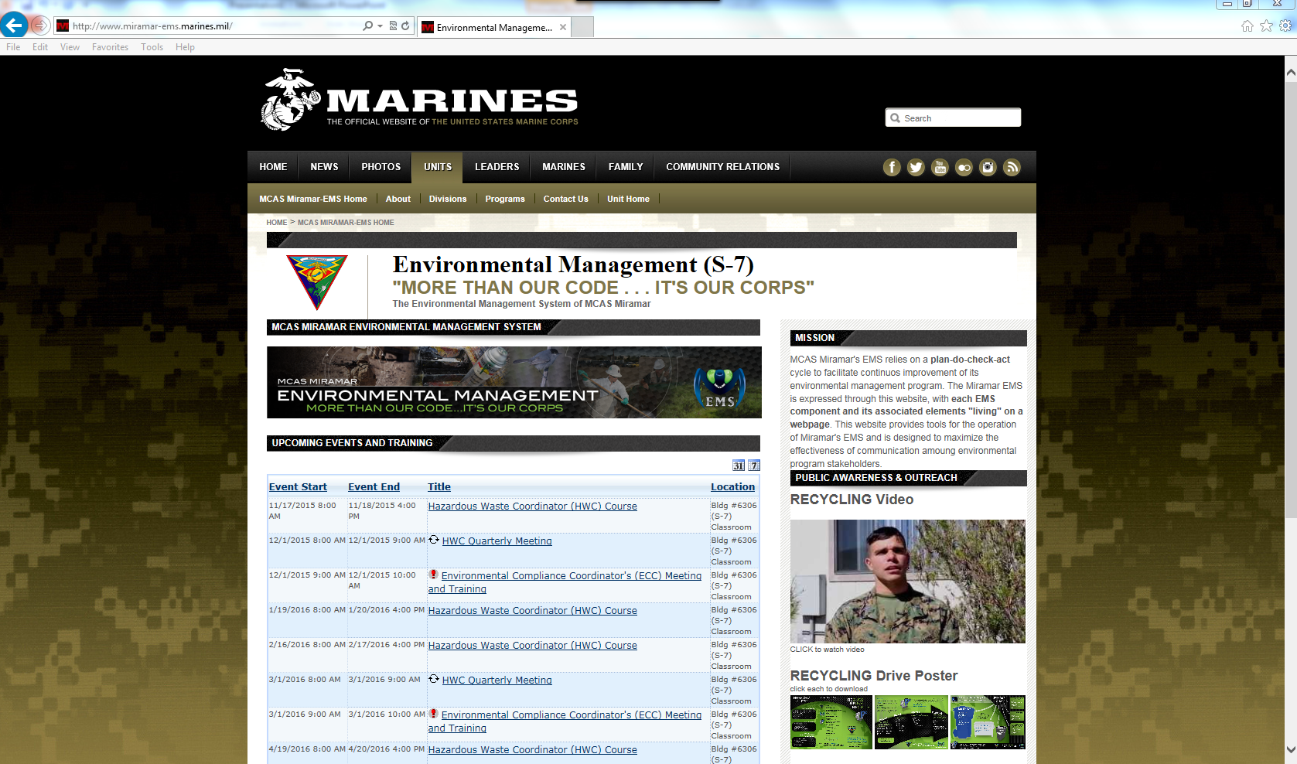
Your source for MCAS Miramar Environmental Information
www.MiramarEMS.com

Slide 3
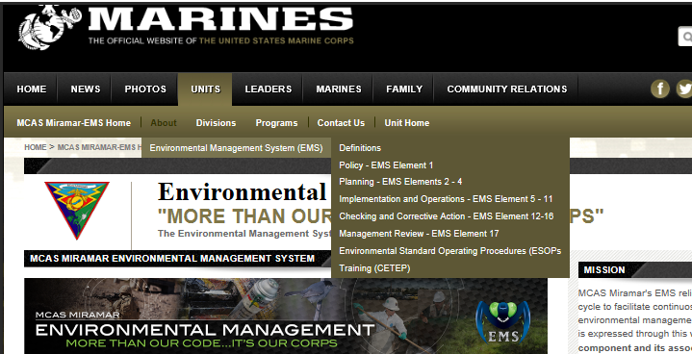
how to use the Website
From your browser, type in www.MiramarEMS.com.
From the homepage along the right side, select the “Environmental Policy Statement” and click “About” in the olive header.

Slide 4
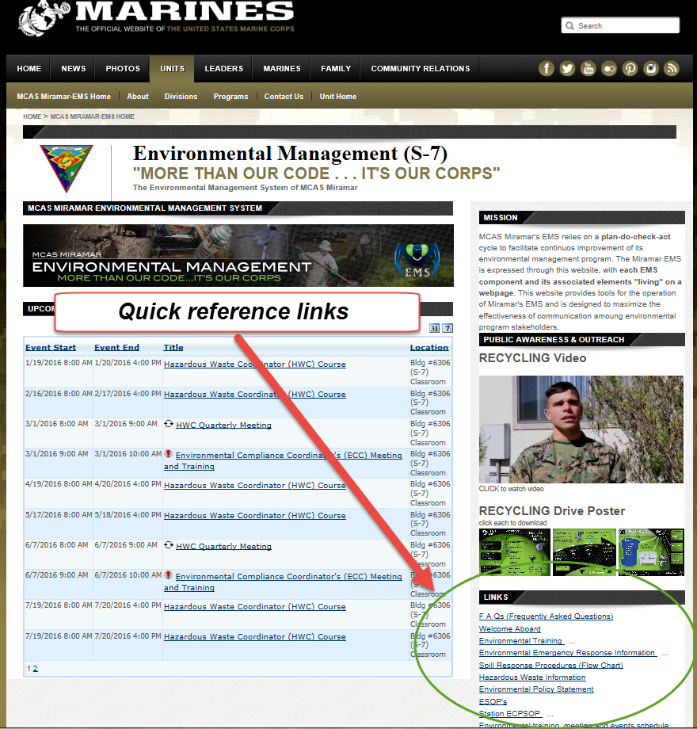
Navigating the Website
Quick links can be found in lower right corner of website

Slide 5
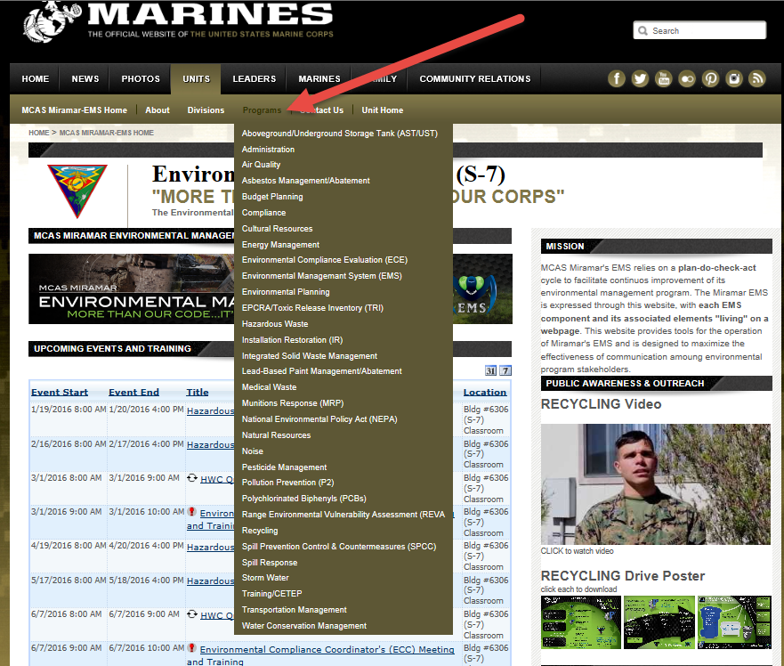
Navigating the Website
Training schedule is available on front page
For specific environmental information, click on “Programs” in the bronze colored banner to open up drop down menus

Slide 6
What are you responsible For?
Familiarize yourself with www.MiramarEMS.com.
Understand the potential impacts associated with the work processes of your unit.
Know your permits and know what is required to comply with the permit conditions.
Attend all meetings and ECC trainings.

Slide 7
WHAT ARE YOU RESPONSIBLE FOR?
Know which ESOPs apply to your operations and ensure each person responsible for that process (practice) is knowledgeable about and has training document on the ESOP.
Ensure that individuals subject to environmental training have received that training (per MCO P5090.2)
Ensure environmental reporting requirements and inspection of facility has been accomplished and properly documented.
Call Environmental if you have any questions.
(858)577-1306

Slide 8
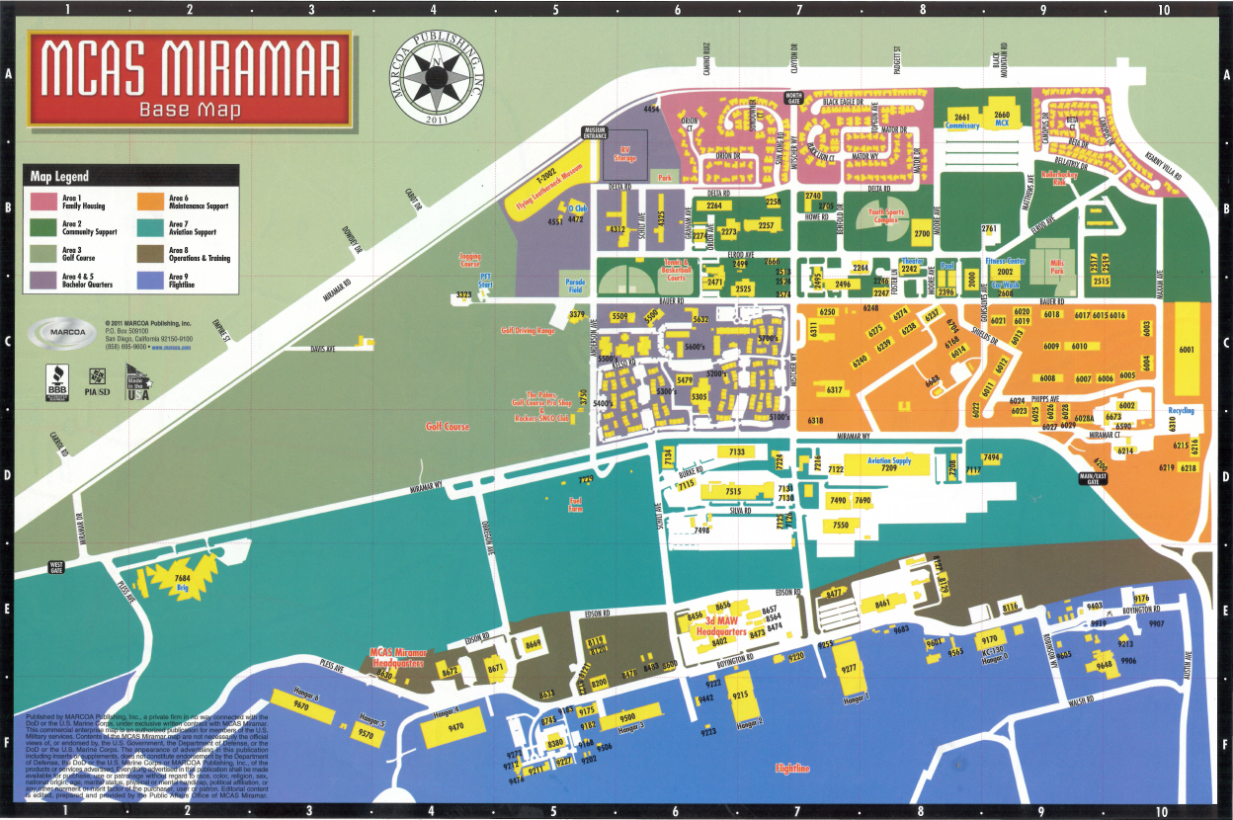
MCAS Miramar: Operation Areas

Slide 9
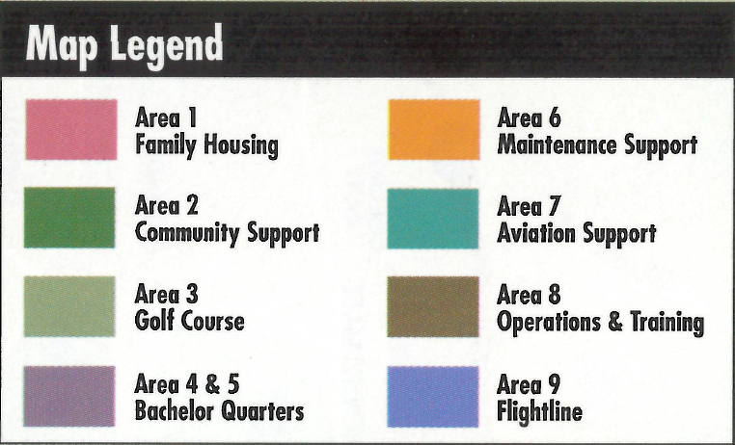

MCAS Miramar: Operation Areas
Areas 1-5 (Marine Corps Community Support) – Primary Environmental Concerns
          Stormwater pollution
          Spills
          Wastewater (sewer)
          Hazardous waste disposal
          Medical waste
          Pollution prevention (P2)
            Recycling

Slide 10
MCAS Miramar: Operation Areas
Areas 6-9 (Mission Ops and Support) – Primary Environmental Concerns
Hazardous waste disposal
Air Permitting for:
  Abrasive Blast Booths
  Aircraft Parts Coating Operations
  Arresting Gear Engines
  Boilers
  Emergency Diesel Generators
  Paint Spray Booths
  Solvent Cleaning/Degreasing
Stormwater pollution
Spills
Wastewater (sewer)
Pollution prevention (P2)
  Recycling
  Bio parts washers
  Pad & towel wringers
  Laundered packs and towels

Slide 11
How This Presentation is Organized
Rules vs. Steps
Rules
  These are requirements established by the regulators that you are looking to fulfill.
  We paraphrased them and made them simpler to understand.
Steps
  These are the steps and action items you can follow to make sure that you’re following the rules.

Slide 12

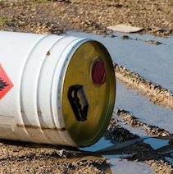
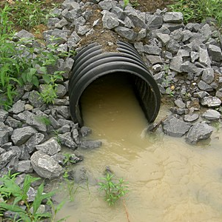
Basic environmental compliance
TOPICS: Environmental issues concerning MOST areas of the base.

Slide 13
Basic Environmental Compliance
Environmental issues identified in this section affect most areas of the base.
TOPICS
  Pollution prevention (recycling)
  Hazardous waste accumulation and disposal
  Spill prevention & response
  Stormwater pollution prevention
  Natural & Cultural resources

Slide 14
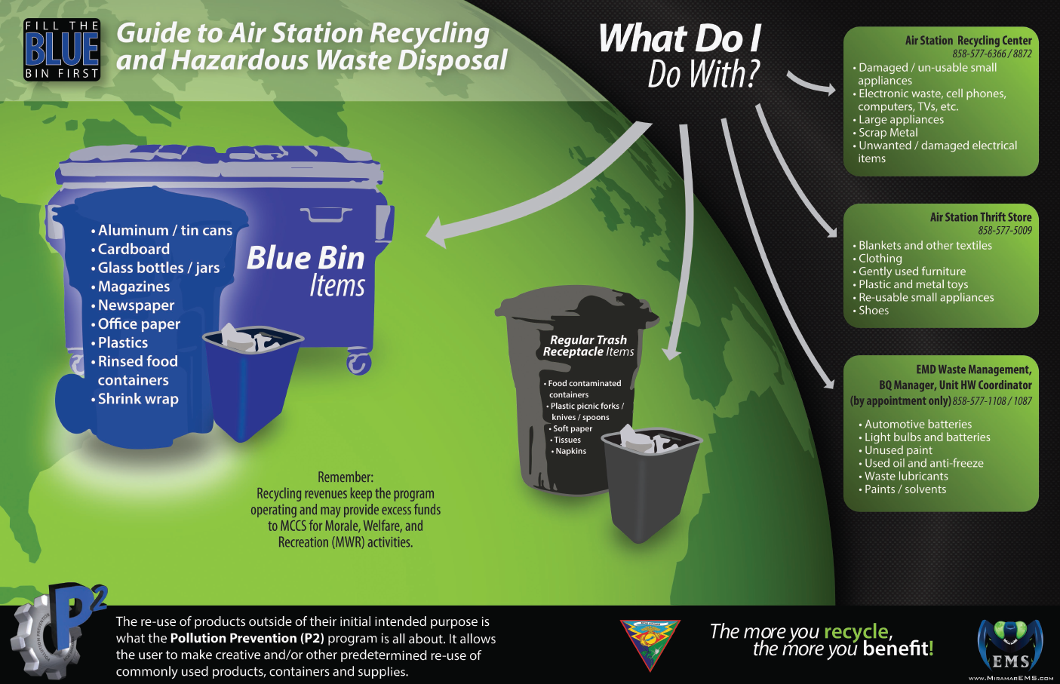
Recycling

Slide 15
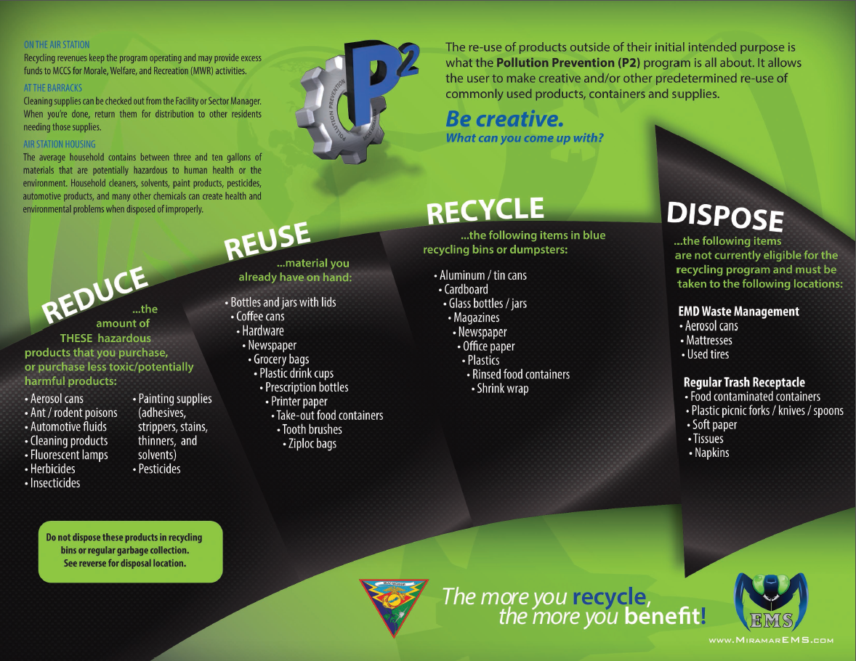
Recycling

Slide 16
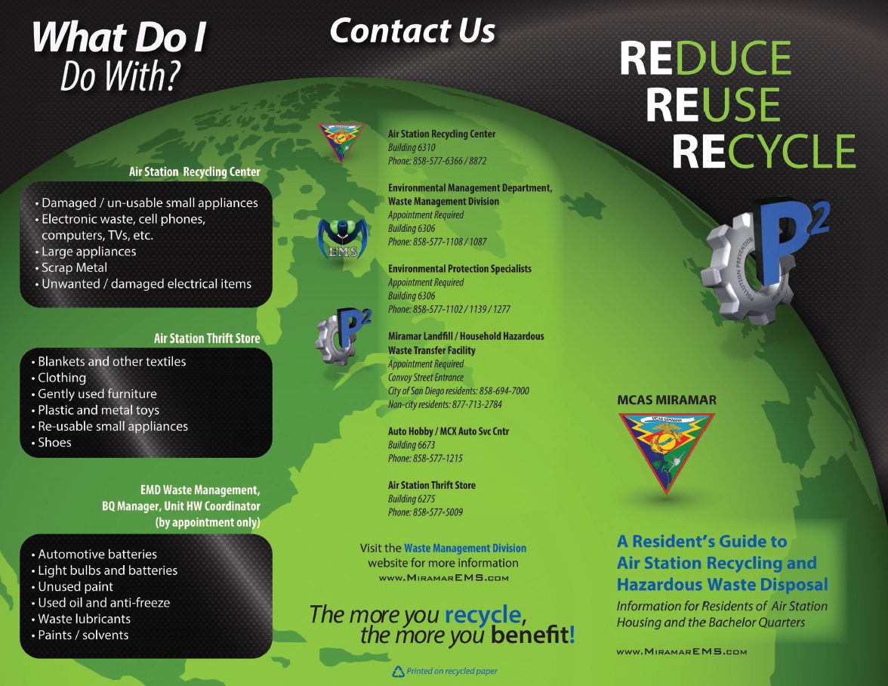
Recycling

Slide 17
Stormwater compliance
General Info:
      Water pollutants include
        dredged soil,
        solid waste,
        incinerator residue,
        sewage,
        garbage,
        sewage sludge,
        munitions,
        chemical wastes,
        biological material,
        radioactive materials,
        heat,
        wrecks or
        discarded equipment, rock, sand, cellar dirt, and industrial, municipal and agricultural waste discharged into water.

Slide 18
Stormwater compliance
Best Management Practices
  Label all drums, cans, containers, tanks and valves
  Perform regular cleaning and regular pavement sweeping
  Avoid hosing down the site
  Recycle
  Store waste and recycling materials in proper containers
  Keep lids closed on all waste receptacles and HAZMAT drums

Slide 19
Stormwater compliance
Best Management Practices
  Limit significant materials inventory
  Routinely clean catch basins
  Keep equipment and vehicles clean
  Stencil signs on storm drain inlets
  Check vehicles and equipment for leaks
  Park vehicles on an impervious surface
  Discharge wash water to a sanitary sewer

Slide 20
Stormwater compliance
Best Management Practices
Wash vehicles and equipment only at EMD-approved wash racks.
Use drip pans underneath leaking aircraft, vehicles, and equipment.
Substitute non-toxic or less toxic cleaning solvents.

Slide 21

Natural Resources
Rules:
  NO OFF-ROADING
  “Taking” of any protected plant or animal species is prohibited
  Ground disturbing activities prohibited
  Concentrated foot traffic in non-training areas is prohibited

Slide 22
Natural Resources
PENALTIES
  Penalties to individuals who violate could include fines up to $200,000 and 1 year imprisonment per take.
  General Rule of Thumb: If nature put it there, leave it there.

Slide 23
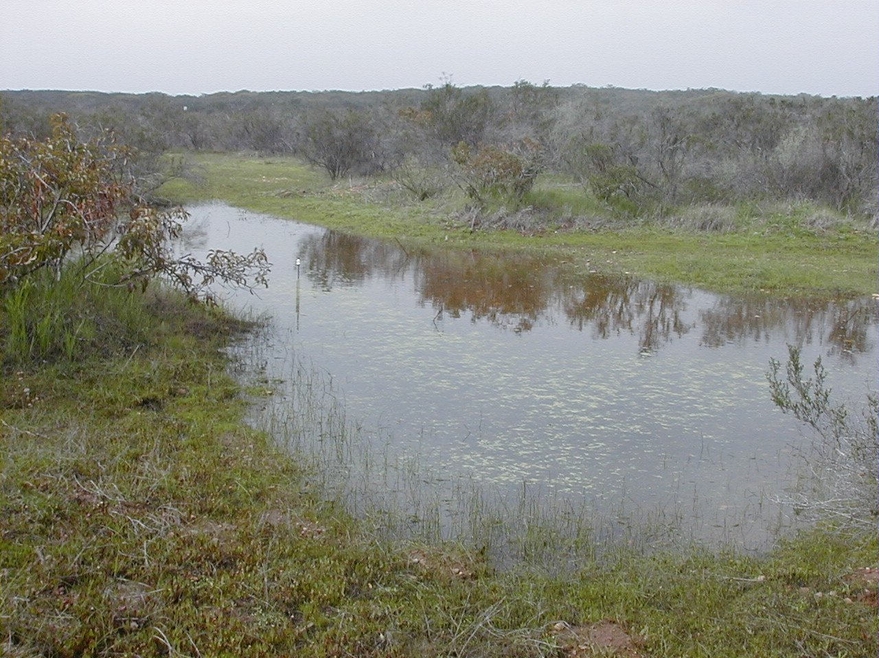
VERNAL POOLS (Wet Season)

Slide 24
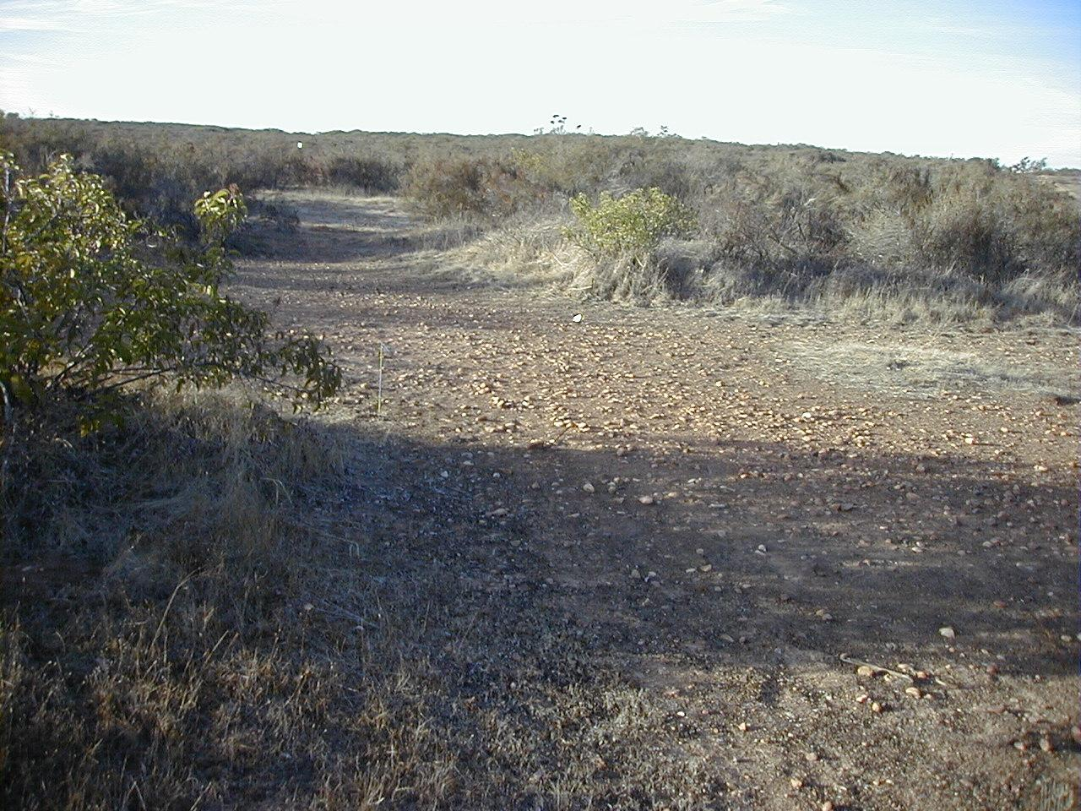
VERNAL POOLS (DRY season)

Slide 25
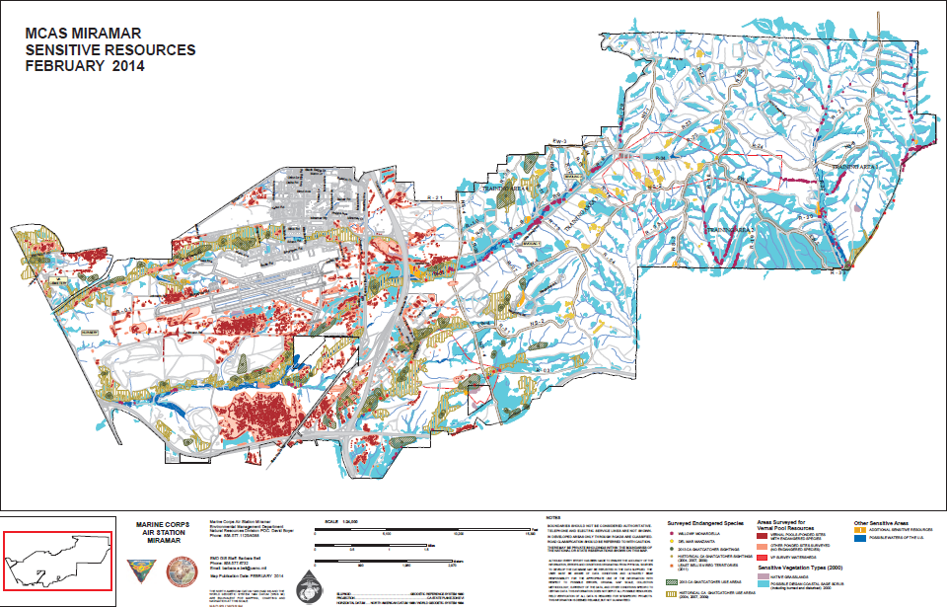

Slide 26

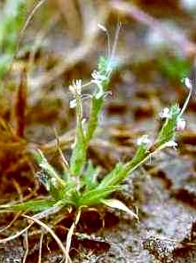
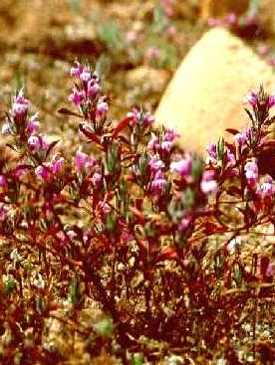
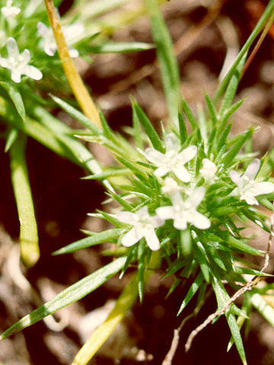
Vernal Pool Plant Species
Left to Right:
SD Button Celery
CA Orcutt Grass
SD Mesa Mint
CA Spreading Navarettia

Slide 27

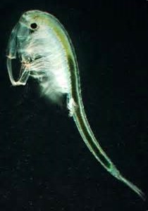
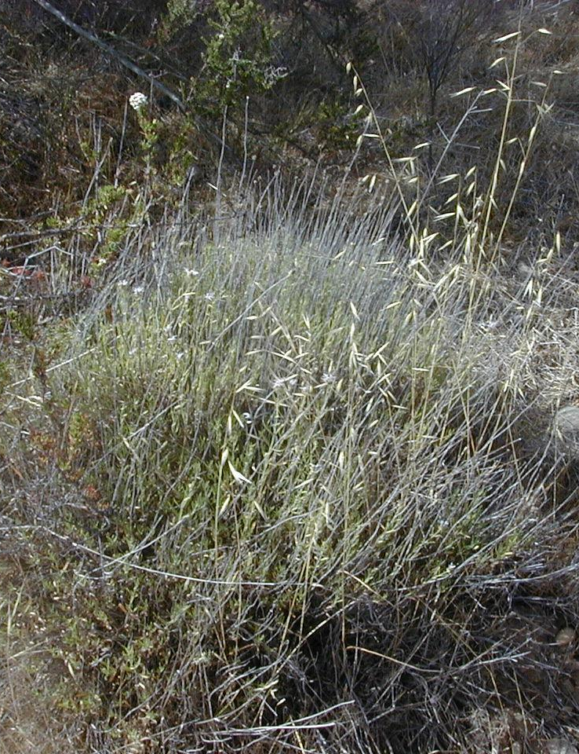

Least Bell’s Vireo
(Federally Endangered)
San Diego Fairy Shrimp (Federally Endangered)
Willowy Monardella
(Federally Endangered)
California Gnatcatcher
(Federally Threatened)

Slide 28

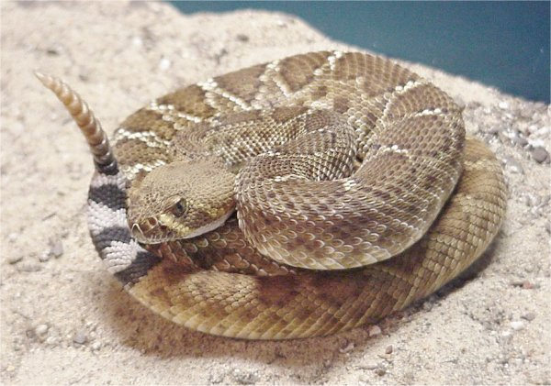



Watch for These!

Slide 29
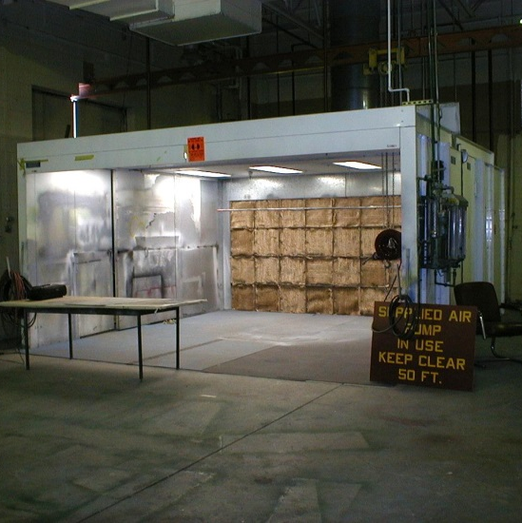
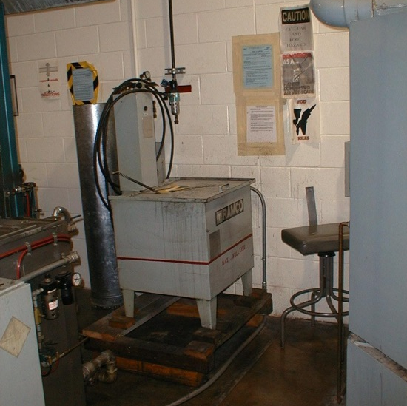
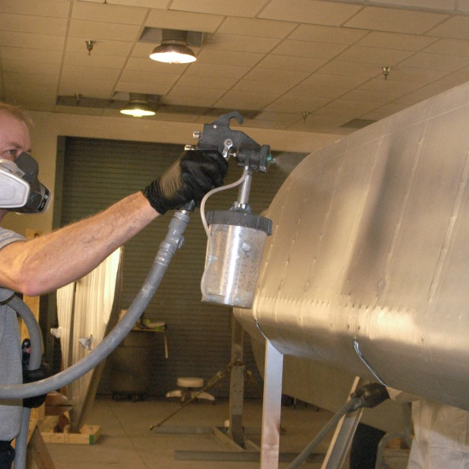
Advanced environmental compliance
TOPICS: Additional environmental issues concerning:
(Areas 6-9) Flightline, Operations, Aviation Support and Maintenance

Slide 30
Advanced Environmental Compliance
TOPICS
  Air Permitting Issues:
    Abrasive Blast Booths
    Aircraft Parts Coating Operations
    Boilers
    Internal Combustion Engines
      Arresting Gear Engines
      Emergency Diesel Generators
    Paint Spray Booths
    Solvent Cleaning/Degreasing
  Pollution Prevention (P2)
    Bio parts washers
    Pad & towel wringers
    Laundered packs and towels
  Medical Waste requirements

Slide 31
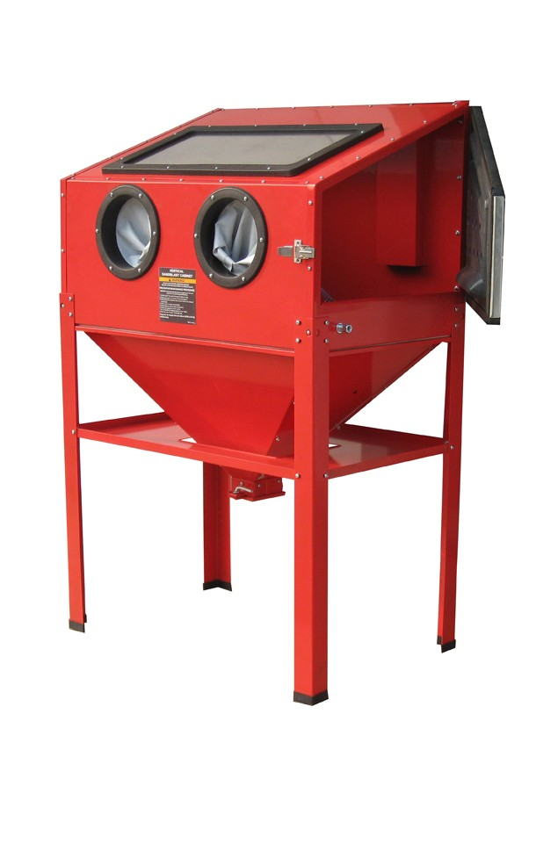
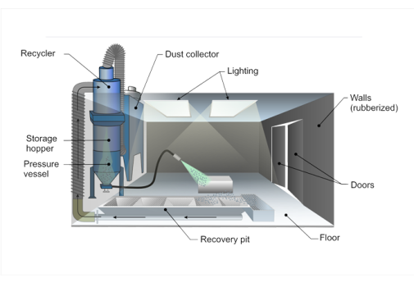
Abrasive Blasting
Blast Booth
Blast Cabinet

Slide 32
Abrasive blasting
Rules:
  Read and follow your permit conditions.
  Abrasive blast wastes should be tested to determine if they are hazardous if not already done.
  Turnover folder must contain:
    Operating instructions
    Required maintenance documents
    Operational logs

Slide 33
Abrasive blasting
Steps
  Display a current permit onsite.
  Read and follow all permit conditions. Contact MCAS Miramar Environmental prior to operation if any conditions are unclear.
  Allow only authorized personnel to operate blast booth.
  Ensure that blast booth is sealed closed during operation.

Slide 34
Abrasive blasting
Steps: (continued)
  Make no modifications to the booth.
  Hazardous blast grit should follow normal hazardous waste accumulation rules.
  The operator shall keep characteristic information of the certified abrasives being used at the site.

Slide 35

AIRCRAFT Parts Coating

Slide 36
Aircraft parts coating
Rules:
  Air pressure gauge or other measuring devices required by the manufacturer to demonstrate HVLP compliance must be readily available and shall be used to calibrate HVLP gun before use.
  HVLP coating application equipment cannot operate at pressure greater than 10 psig at the outlet.

Slide 37
Aircraft parts coating
Rules: (continued)
Maintain a daily coatings and solvents usage log with information to include:
    Strippers for surface preparation.
    Coating application equipment cleaning.
    Amount of coating used.
    Description of substrate coated (e.g., metal parts, aerospace component, etc.).
    Description of coating applied (e.g., base coat/primer, hardener, thinner, clean-up, top coat, surface prep, etc.).
    Manufacturer name and ID.
    Mix ratios.
    Volume of VOC-containing material used.

Slide 38
Aircraft parts coating
Rules: (continued)
  Maintain an updated copy of the Aerospace Coating List (ACL)
    Contact EMD, ATTN: Air Quality Program Manager to obtain latest copy of ACL
  Maintain a copy of the Material Safety Data Sheet (MSDS) of all aerospace coating and solvent products used.

Slide 39
AIRCRAFT Parts COating
Steps:
  Make sure that all supporting documents are available onsite.
    Permits
    Material Safety Data Sheets (MSDS)
    Operation Logs & Records
  Read permit and comply with permit conditions.
  Only use authorized HVLP equipment.
  Complete required recordkeeping:
    Daily coating and solvent usage records.
    Summarize daily usage data into a Monthly Usage Record and submit a copy to the EMD Air Quality Program by month’s end.
    Acquire AULs for all materials prior to use.
  Maintain records for at least 3 years.

Slide 40
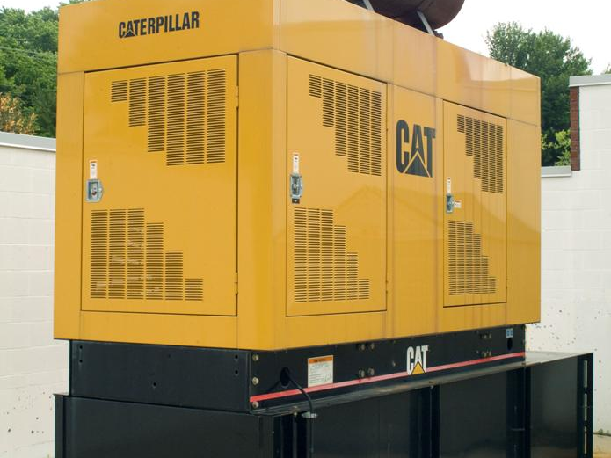
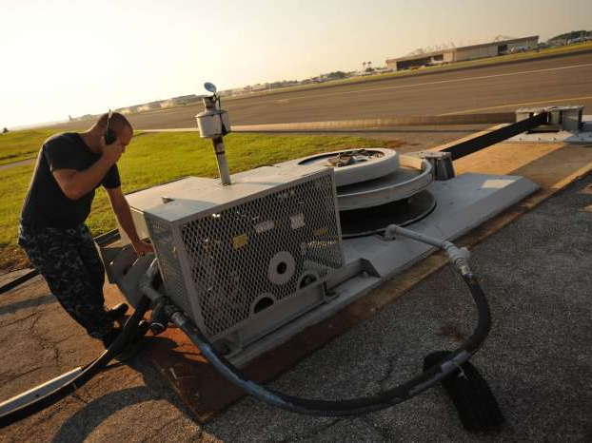
Internal Combustion Engines
Emergency Diesel Generators
Arresting Gear Engines

Slide 41
Internal combustion engines
Rules
  Permit required for engines 50 BHP or greater.
  Permit must be at equipment site at all times.
  Certain records must be kept onsite:
    Engine manufacturer name and model number
    Engine serial number and EPA family number
    Brake horsepower rating
    Combustion method
    Fuel type
    California diesel certification
    Manual of recommended maintenance

Slide 42
Internal combustion engines
Rules: (continued)
  An operating log must be filled out with the following information:
    Dates and times of engine operations (emergency & non-emergency).
    Total cumulative hours of operation per calendar year, based on actual reading of engine hour or fuel meter.
    Records of engine maintenance, including dates when engine maintenance was performed.
  All records must be retained onsite for at least 5 years.

Slide 43
Internal combustion engines
Steps:
  Post your permit.
  Fill out operation logs after each use.
  Ensure that all records are maintained onsite.
  Inspect equipment for flaws, leaks or other problems.
  Do not exceed allotted maintenance and testing hours.
  Contact EMD Air Quality Program Manager immediately when engine hour meter failed and replace.

Slide 44
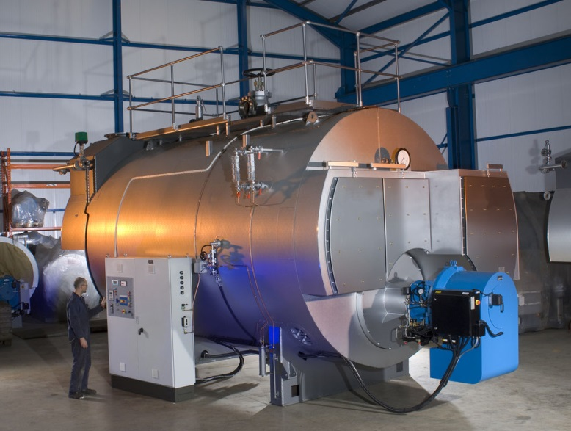
Boilers

Slide 45
Boilers
Rules:
  Boilers with a capacity of over 1 million BTU/Hr fired on liquid fuel oil/diesel require a permit to operate.
  Boilers with capacity of over 5 million BTU/hr fired exclusively on natural gas or LPG require permits.
  Permit must be available at the boiler site.
  Fuel usage must be tracked.
  Annual reports on usage may need to be generated.
  Boiler unit should be labeled with certification status (i.e. brand name, model number, heat input rating, NOx and CO emission test results)

Slide 46
Boilers
Steps:
  Post permit onsite.
  Track fuel usage.
  Inspect boiler for leaks or flaws.

Slide 47

Paint booth

Slide 48
PAINT Booths
Rules:
  The exhaust fans and exhaust filters must be installed and operating properly when the paint booth is in use.
  All doors of the paint booth shall remain closed at all times when coating operations are being conducted, except when personnel are entering or exiting the paint booth.
  When the paint booth is used for coating aircraft parts, all rules applicable to aircraft parts coating shall apply to the operation of the paint booth.
  Permits must be displayed at paint booth site.

Slide 49
Paint Booths
Steps:
  Display your permit at paint booth site.
  Clean exhaust filter regularly and ensure exhaust fans are operational.
  Inspect pressure drop across filters during use and record pressure readings when required by permit.
  Ensure that manometer and exhaust fan are functional.

Slide 50
Paint Booths
Steps: (continued)
  Close solvent containers except when filling.
  Close paint cans when not in use.
  Keep fire extinguisher and spill kit nearby.
  Conduct and document monthly paint booth inspections.
  Notify MCAS Miramar Environmental before planning any modifications or repairs to the paint booth.
  Maintain records as required by paint booth permit conditions.

Slide 51
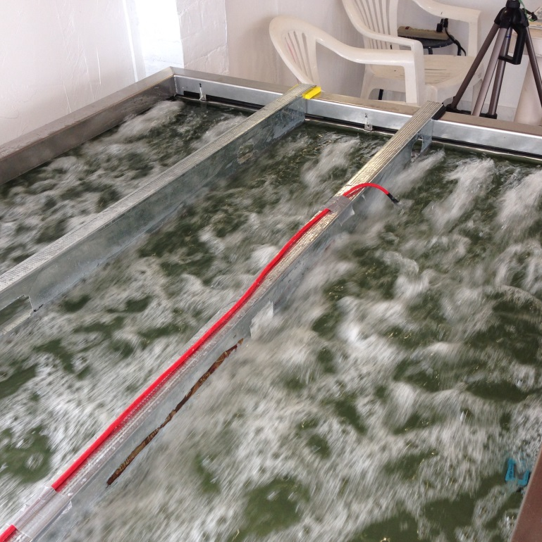

Solvent Cleaning/Degreasing
Solvent Dip Tank
Parts Cleaner

Slide 52
Solvent Cleaning/Degreasing
General Rules:
  Permits must be posted onsite.
  Fluid level line indicating maximum allowable solvent level must be marked.
  Operating instructions must be posted on solvent cleaners.
  Solvent cleaners must be covered by lid when not in use.
  Maintain daily use records on site for at least 3 years. Records should include:
    Dates of solvents added to and removed from each solvent cleaner.
    Quantity and method of disposal for waste solvents.

Slide 53
Solvent Cleaning/Degreasing
Operating Rules
  Solvent agitation may only be achieved by means of pump circulation, mechanical mixing, or ultrasonics.
  Lid/cover must be closed when solvent is not in use.
  No porous or absorbent materials can be cleaned with solvent.
  Ventilation system and emissions control equipment must be functional.

Slide 54
Solvent cleaning/degreasing
Operating Rules (continued)
  Solvent flow must be a continuous fluid stream. Fine, atomized or shower-type sprays are not permitted.
  Leaky equipment shall be repaired prior to use.
  Solvent cleaner shall not be exposed to air drafts.

Slide 55
Solvent Cleaning/Degreasing
Steps:
  Post your permit.
  Keep all records onsite for at least 3 years.
  Keep copy of MSDS with VOC info for all materials containing organic solvents.
  Operate cleaners/degreasers according to directions.
  Fill out usage records after each use.
  Notify MCAS Environmental if you plan to change solvents.

Slide 56
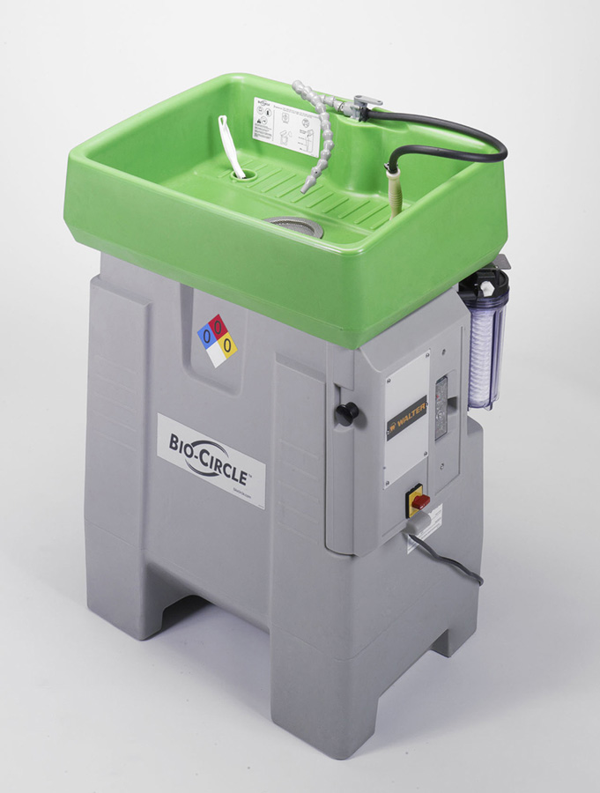
P2 - Bio Parts Washer
Benefits:
Reduces amount of HW generated on base.
Reduces release of harmful pollutants.
Increases user safety.
Utilizes microbes in bioremediation instead of chemicals to breakdown greases and oils.
Degreasing solutions are pH neutral, non-caustic, have no flash point, and don’t irritate skin.

Slide 57
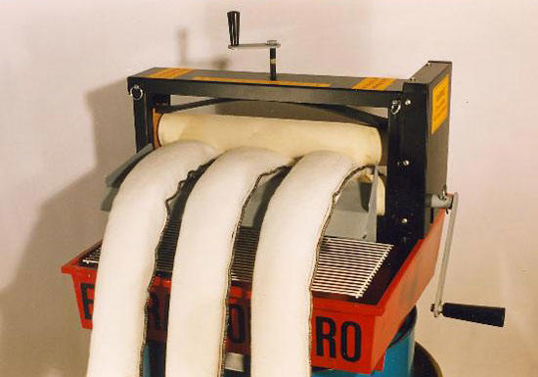
P2 – Pad/ Towel wringer
Benefits:
Allows for reuse of expensive spill containment equipment.
Saves money for the Marines.
Easy to use.
Reduces solid waste generation.

Slide 58

QUESTIONS?
www.MiramarEMS.com

