Slide 1
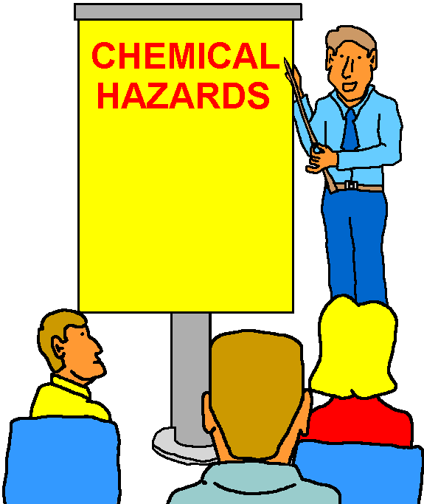
Consolidated Emergency Response/Contingency (CERC) Plan Training
Section 3
Using
Emergency
Response Equipment
Please print and sign your name on the training roster.
Persons Trained: Hazardous Material/Waste Handlers/ECCs (Annual Training Requirement)

Slide 2
LEARNING OJECTIVES
Terminal Objective: Meet the Consolidated Emergency Response/Contingency Plan annual training requirement for using and maintaining our unit’s spill equipment.
Enabling Objectives:
  Respond to an “incidental spill” effectively, efficiently, and economically.
  Recognize “emergency response” situations.
  Be familiar with spill equipment on-hand: pads, shop towels, wringer, neutralizing agents, eyewash, PPE, fire extinguisher.

Slide 3
BACKGROUND
Use the spill response equipment we have on-hand to effectively and economically control, clean-up a spill, or otherwise neutralize a hazard.
Most accidental spills and leaks are minor and within our response capabilities.

Slide 4
Consolidated Emergency Response/Contingency Plan
The Consolidated Emergency Response/Contingency Plan is a requirement for units that generate hazardous waste.
Sections A - K:
Some items that will be covered include:
  * Emergency Response Plan w/Site Map
  * Employee Training Description
  * Emergency Equipment Inventory

Slide 5
CONTINGENCY PLAN SECTION G
EMERGENCY RESPONSE EQUIPMENT
Inventory of spill response equipment on-hand and quantities (as needed).
Includes absorbents, booms, pad wringer, spill containment devices, drip pans, personal protection equipment, communication equipment (whistle, horn, siren, inter-com, etc.).
Location and capability of equipment.
Inspect equipment weekly to ensure it is stocked and ready to use when needed.
Equipment re-stocked and replaced as needed.

Slide 6
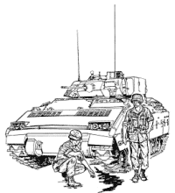

INCIDENTAL SPILLS
(Non-Emergency Spills)
Spill control and clean-up within the unit’s capability.
Unit’s are required to have adequate spill response equipment and supplies.
Unit personnel should be familiar with hazards present and be able to adequately protect against them.

Slide 7
SPILL RESPONSE EQUIPMENT
Have spill response and clean up equipment on-hand when handling HM, but especially when pouring, spraying, or transferring.
When cleaning up spills, use a limited number of shop towels, pads, or oil mops repeatedly by wringing them out. This will reduce waste.
Spills need to be cleaned immediately no matter where they occur.
Red Shop Towels
Absorbent Pads
Absorbent Socks
Pad Wringer
POL Mops
Mercury Spill Kit
Neutralizers

Slide 8
SPILL RESPONSE EQUIPMENT(2 of 2)
Mercury Spill Kit should be on-hand if test equipment, thermometers, gauges, etc. are used that contain mercury.
Neutralizers should be on-hand:
  Acids: neutralize with a weak alkali (sodium bicarbonate or baking soda).
  Alkalis: neutralize with a weak acid (boric acid).

Slide 9
SPILL CONTAINMENT
Some Waste Accumulation Sites have concrete containment cells. Shop towels and pads can be rolled up and used for berming or diking spills.
Towels and pads could also be used to divert spills away from storm and sewer drains or to block the drain to prevent the spill from causing further or increased contamination.
Berming
Diking
Diverting
Blocking

Slide 10
DEMONSTRATION/SPILL DRILL
Demonstrate berming, diking, diverting, and blocking techniques with towels and pads.
Point out storm drains and sanitary sewers in your work area that may be affected by a spill.
Demonstrate the use of permanent secondary containment in your work area, i.e., the drain valves at your waste site or above ground storage tanks.

Slide 11
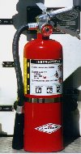
FIRE EXTINGUISHERS
Pull the pin at the top of the extinguisher that keeps the handle from being accidentally pressed.
Aim the nozzle toward the base of the fire.
Squeeze the handle to discharge the extinguisher while standing about 8 feet away from the fire.
Sweep the nozzle back and forth at the fire’s base.
P A S S
Pull, Aim, Squeeze, and Sweep

Slide 12
EYEWASH/SHOWER
In accordance with SDSs.
Required for any environment that exposes workers to HM/HW
  Waste Accumulation Sites
  Work areas where acids or bases are handled
“Immediately” available or within 10 seconds of walking.
Must flush eyes/skin for at least fifteen minutes.
Contact Station Safety for assistance.

Slide 13
DECONTAMINATION
Decontaminate spill clean up tools after use. (May be as simple as water rinsing).
Decontaminate self after HM/HW use or spill cleanup. See SDS for recommended solvents, procedures, etc.
Dispose of used materials as appropriate, or store for reuse.

Slide 14
PERSONAL PROTECTIVE
EQUIPMENT (PPE) (1 of 3)
Gloves: Choose the right glove when handling hazardous chemicals (see SDS)
  Butyl Rubber, Nitrile, Latex, Viton, etc.
  Disposal or Re-usable.
Eye Protection: In case of splash hazards, dust/dirt, flying objects
  Goggles
  Safety Glasses
  Face Shield (worn w/goggles or safety glasses)

Slide 15
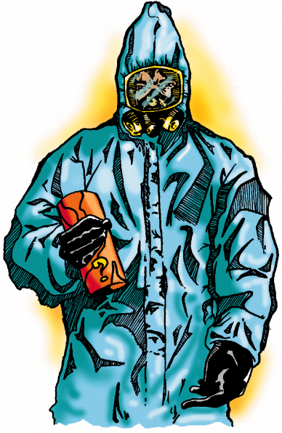
PPE (2 of 3)
Aprons: Provides nominal body protection.
  Butyl Rubber, Nitrile, or Plastic
Tyvek™ Coveralls: Increased body protection.
  Non-coated: for dusts and particulates
  Coated: for sprays, mists, droplets, and light splashes
Safety Boots: Steel-toed foot protection.
Chemical Over-Boots: Non-absorbent polyester for chemical splash protection.

Slide 16

PPE (3 of 3)
Select the correct PPE when working with HM/HW and cleaning up spills.
Maintain PPE in good working condition by cleaning it after use and storing it properly between uses.
Discard and replace degraded and unserviceable PPE.

Slide 17
DEMONSTRATION
Demonstrate donning/doffing the PPE used in the various operations at your unit.
Demonstrate PPE and skin decontamination (cleaning) with warm water and a mild detergent.
Demonstrate the proper storage of PPE, i.e., respirators, aprons, eye protection, and gloves.

Slide 18
REVIEW
Use PPE when working with HM.
Use care when pouring, spraying, or dispensing HM/HW.
Keep drip pans, shop towels and absorbent pads adequately stocked and nearby.
Clean up incidental spills immediately.
Call 911 in case of emergencies!
Sign-in on the Training Roster (CERC).

Slide 19
QUESTIONS?
Contact your unit’s Hazardous Waste Coordinator (HWC) or your Group’s Environmental Compliance Coordinator (ECC) for spill cleanup procedures assistance.
Unit and Group HWCs/ECCs should contact the Environmental Department’s CETEP Coordinator at 307-1306 for questions regarding this presentation and/or for training assistance.

